Slide 1
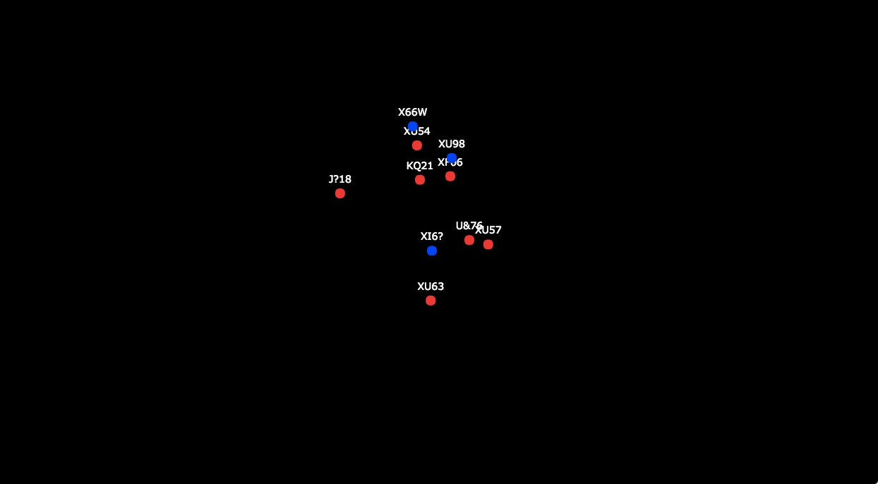

Cognitive workload measurement and new estimation techniques
Reilly Innes
Supervisors: Scott Brown & Ami Eidels

Slide 2
Overview
Vaguely introduce my research area
Project 1 – validating a design
Project 2 – using this design
Project 3 – also using this design but differently
Project 4 – using those results to inform another study (this one is cool and has helicopters though)
Break
Some modelling project
Why I’m so excited about it
What this will mean for future models

Slide 3

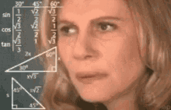
Cognitive Workload Limitations
Resources are a finite pool
Not enough resources available → Overload
Overload → mistakes and ↓ performance
Overload = too many tasks OR too difficult
“Underload” also exists

Slide 4
Detection [D] Response [R] Task [T]

Slide 5

DRT
Participants are given a short stimulus, usually a light or vibration, lasting for 1 second
Participants respond as quickly as possible
Stimulus occurs every 3-5 seconds
Fast responses = Low workload Slow responses = High workload

Slide 6
Usually used in driving

Slide 7
For
Conversations between passengers
Tillman, G., Strayer, D., Eidels, A., & Heathcote, A. (2017). Modeling cognitive load effects of conversation between a passenger and driver. Attention, Perception, & Psychophysics, 79(6), 1795-1803.
Drews, F. A., Pasupathi, M., & Strayer, D. L. (2008). Passenger and Cell Phone Conversations During Simulated Driving. Journal of Experimental Psychology: Applied, 14, 000-000.
Smartphone use
Strayer, D.L., & Drews, F. A. (2004). Profiles in driver distraction: Effects of cell phone conversations on younger and older drivers. Human Factors, 46, 640-649.
Strayer, D. L., Drews, F. A., & Crouch, D. J.(2006). A comparison of the cell phone driver and the drunk driver. Human Factors, 48, 381-391.
Strayer, D. L., Watson, J. M. & Frank A. Drews (2010). Cognitive Distraction While Multitasking in the Automobile.
Strayer, D. L., Cooper, J. M., Turrill, J., Coleman, J., Medeiros-Ward, N. & Biondi, F. (2013). Measuring Cognitive Distraction in the Automobile.
Information systems
Strayer, D. L., Turrill, J., Coleman, J. R., Ortiz, E. V. & Cooper, J. M. (2014). Measuring Cognitive Distraction in the Automobile II: Assessing In-Vehicle Voice-Based Interactive Technologies.
Strayer, D. L., Cooper, J. M., Turrill, J., Coleman, J. R., & Hopman, R. J. (2015). Measuring cognitive distraction in the automobile III: A comparison of ten 2015 in-vehicle information systems.
Voice assistants
Cooper, J. M., Ingebretsen, H. & Strayer, D. L. (2014). Mental Workload of Common Voice-Based Vehicle Interactions across Six Different Vehicle Systems.
Coleman, J. R., Turrill, J., Cooper, J. M., & Strayer, D. L. (2016, September). Cognitive workload using interactive voice messaging systems. In Proceedings of the Human Factors and Ergonomics Society Annual Meeting (Vol. 60, No. 1, pp. 1894-1898). Sage CA: Los Angeles, CA: SAGE Publications.

Slide 8
Why it’s actually useful
Measure of cognitive workload
Useful for usability studies
Useful for workload in other applied areas
Useful to discriminate between people

Slide 9
Can we extend the DRT to look at more than just distracted driving?
PhD Research Questions:

Slide 10
Initial work
Thanks to honours Reilly

Slide 11

The trouble with secondary tasks
Timing of dual responses
Psychological Refractory Period
Difficulty of the task
Needs to be hard
Quantifying performance
No tradeoff
Something that isn’t driving
MOT

Slide 12
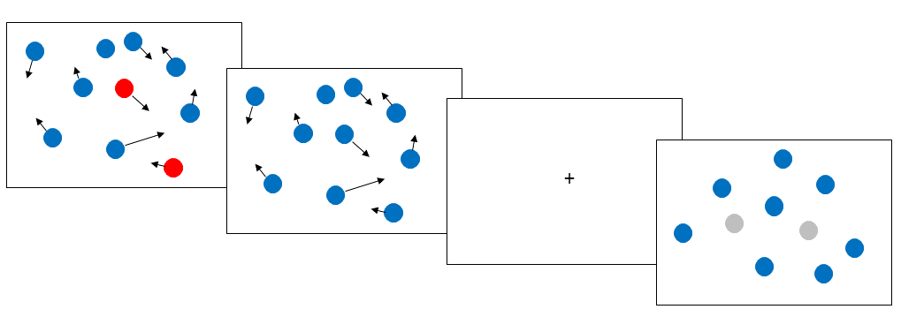
MOT
The Multiple Object Tracking (MOT) task was a proposed secondary
It is
Continuous
Hard
Easily controlled and manipulated
Tests cognitive capacity

Slide 13

Basic

Slide 14

Hard

Slide 15
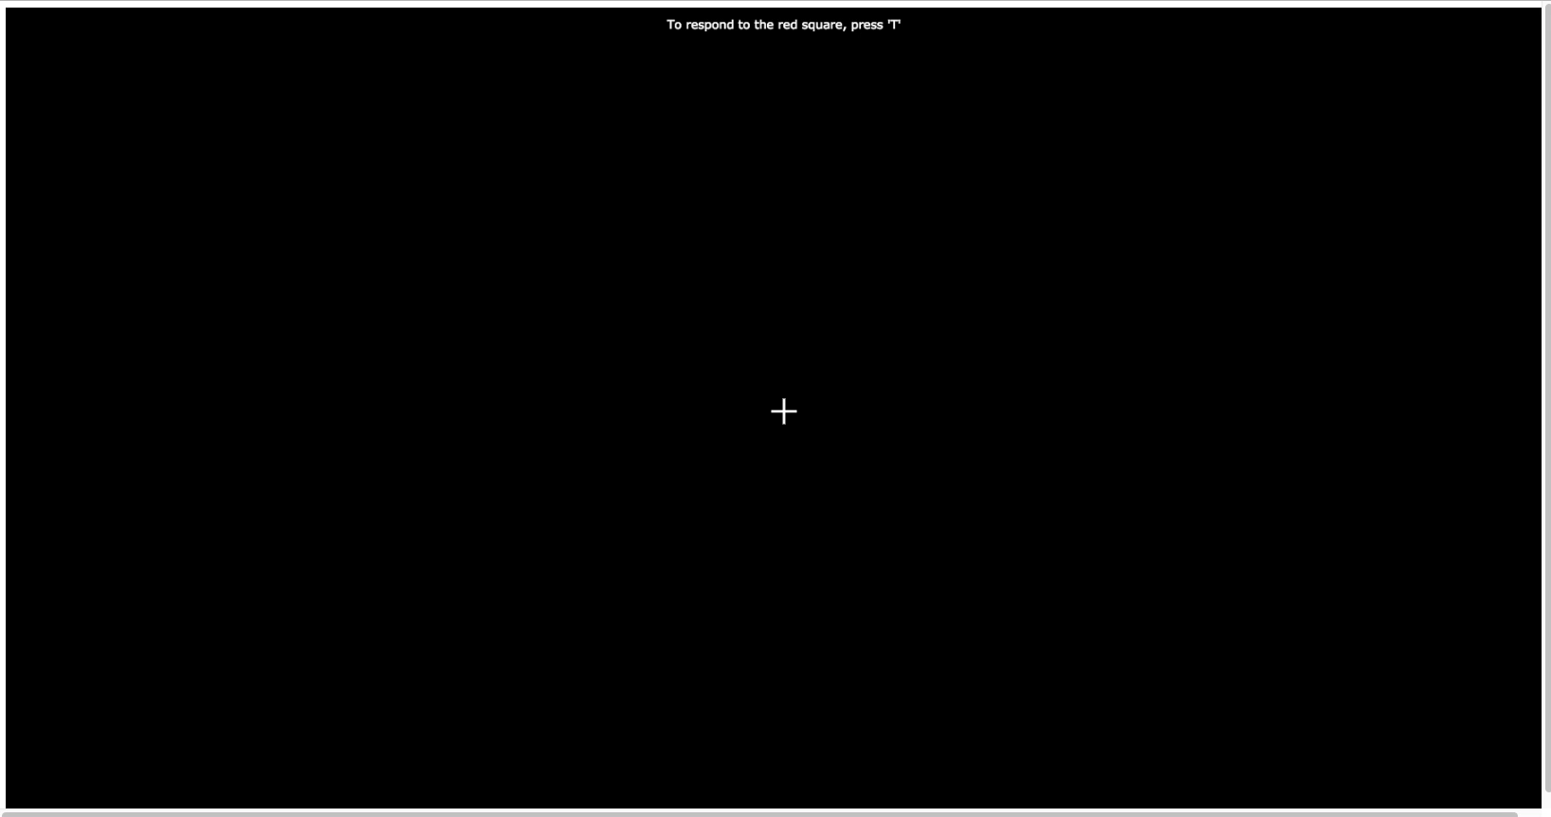
Combined

Slide 16
What results (should) look like
If the MOT paradigm impacts on cognitive load;
MOT accuracy levels decrease as difficulty increases
If the DRT captures this change in workload;
DRT Response times increase as difficulty increases
No trade-off present
Increased difficulty = Decreased performance

Slide 17
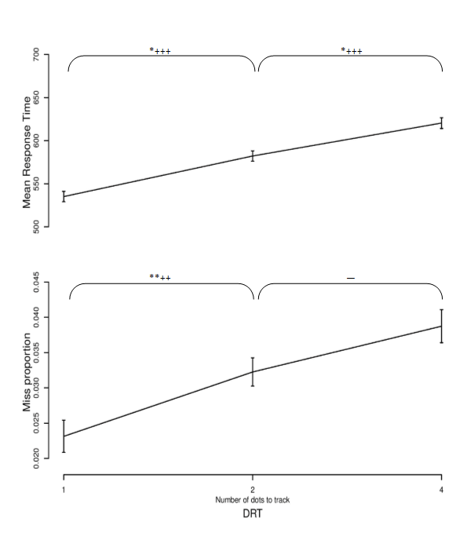
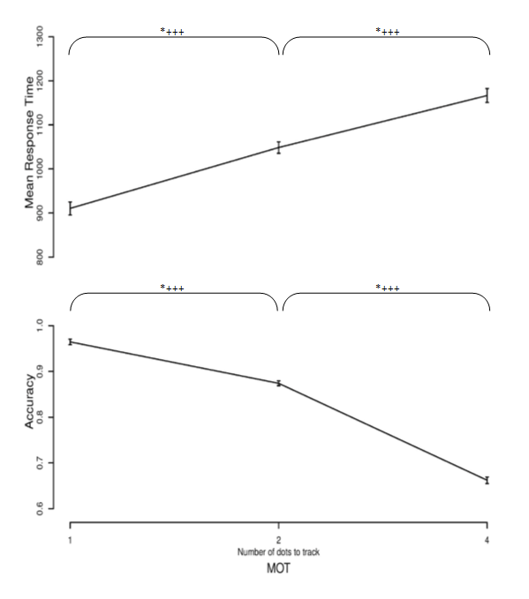
Honours Results

Slide 18
Sensitivity of the DRT
I.e. can we use it to tell people apart?

Slide 19
The data presented here is highly…

Slide 20
Mission Report (Brief)
Last decade….
(2017)
Contact was made with RAAF Squadron 4 (Williamtown RAAF base)
A special forces division
Combat Controller Candidate Selection
They needed our help… (yes, the Government needed our help)

Slide 21

Combat Controller
Role
Track enemies
Receive lots of info
Map movements
Launch attacks
Selection Methods
Cognitive testing
Spatial ability, memory span, speech intelligibility, working memory, attentional control and more
Physical testing
Range of intense fitness tests
Notes:
CC are essentially a heavy metal ATC. Theyre deployed on the ground and required to track allies and enemies on the ground and in the air. They receive information from multiple sources, then they have to manually map this information and translate it to make movements and launch attacks and airstrikes.
Their current selection measures include a battery of cognitive tasks and a range of physical tests. What they wanted to compliment these was a combat controller relevant task. A where good candidates should excel. task they should be really good at.

Slide 22
Step 1: Propose an Ecologically Valid Task
Measure workload differences
In an applicable task
Detection Response Task as the measure
Multiple Object Tracking task as main task
Workload = difficulty = number of tracked targets

Slide 23
DRT
The DRT measures leftover resources from dual tasking
Fast responses = More Resources Slow responses = Less Resources
Same task & same performance
–> fast responses = more available resources (i.e. more starting capacity?)
Could also be explained by;
More efficient allocation of resources (optimal tradeoff)
Decision bias (threshold)
Faster processing (processing speed)

Slide 24
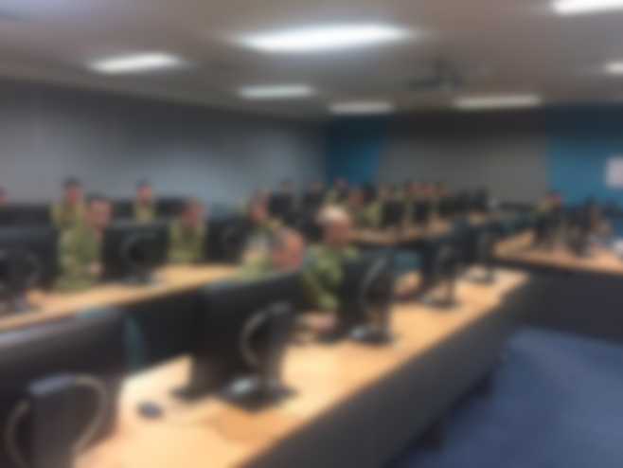
Combat Controller Task
Conditions = 0, 1 or 4 dots to track
0 = no workload – only DRT responses
1 = low workload
4 – high workload
53 Combat Controller trainees tested over three cohorts
30 Trials of each condition
Compared to student group – who were tested online (N = 64) and in lab (N=28)

Slide 25
Groups Outcomes
CC
CC
Student
Student
Response Time
Accuracy
DRT - RT
MOT - Accuracy
Notes:
Make sure you explain slower vs higher

Slide 26
What they care about
They want a way to discriminate between individuals
They don’t want to know that they’re better than students
Step 2: Give them the microfilm (data)

Slide 27
Combat Controller Outcomes
Better Performers
Response Times
Notes:
Add colour graph with students

Slide 28
Combat Controller Outcomes
Better Performance
Darker = Faster DRT
i.e. less loaded
Better Performance

Slide 29
Where to?
Compare selected vs others?
Link to other metrics?
Compare to qualified personnel?

Slide 30
Where to?
Compare selected vs others?
Link to other metrics?
Compare to qualified personnel?

Slide 31
Where to?
Compare selected vs others?
Link to other metrics?
Compare to qualified personnel?

Slide 32
Where to?
Compare selected vs others?
Link to other metrics?
Compare to qualified personnel?

Slide 33
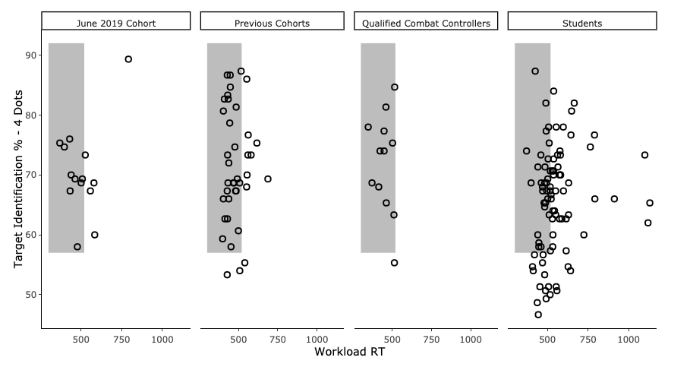
Combat Controller Outcomes

Slide 34
What does this mean?
DRT is effective in showing workload differences between subjects
Group differences exist between students and highly skilled combat controllers
Get military people to do your studies
Future: joint modelling

Slide 35

Modelling

Slide 36
Accumulator Models
Models of Responding
We accumulate evidence
At a rate
We hit a threshold
Can vary with caution
We make a decision

Slide 37
LBA

Slide 38
MOT Modelling
Respond “target”
Respond “not target”

Slide 39
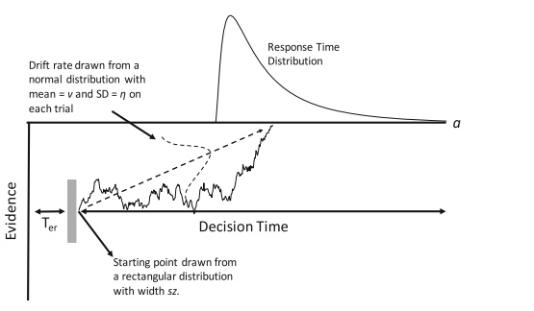
Shifted-Wald - DRT

Slide 40
Models of the RAAF data

Slide 41
The Model
An LBA
With varying threshold and drift
And a threshold bias because responding wasn’t even

Slide 42
Modelling

Slide 43
Modelling

Slide 44
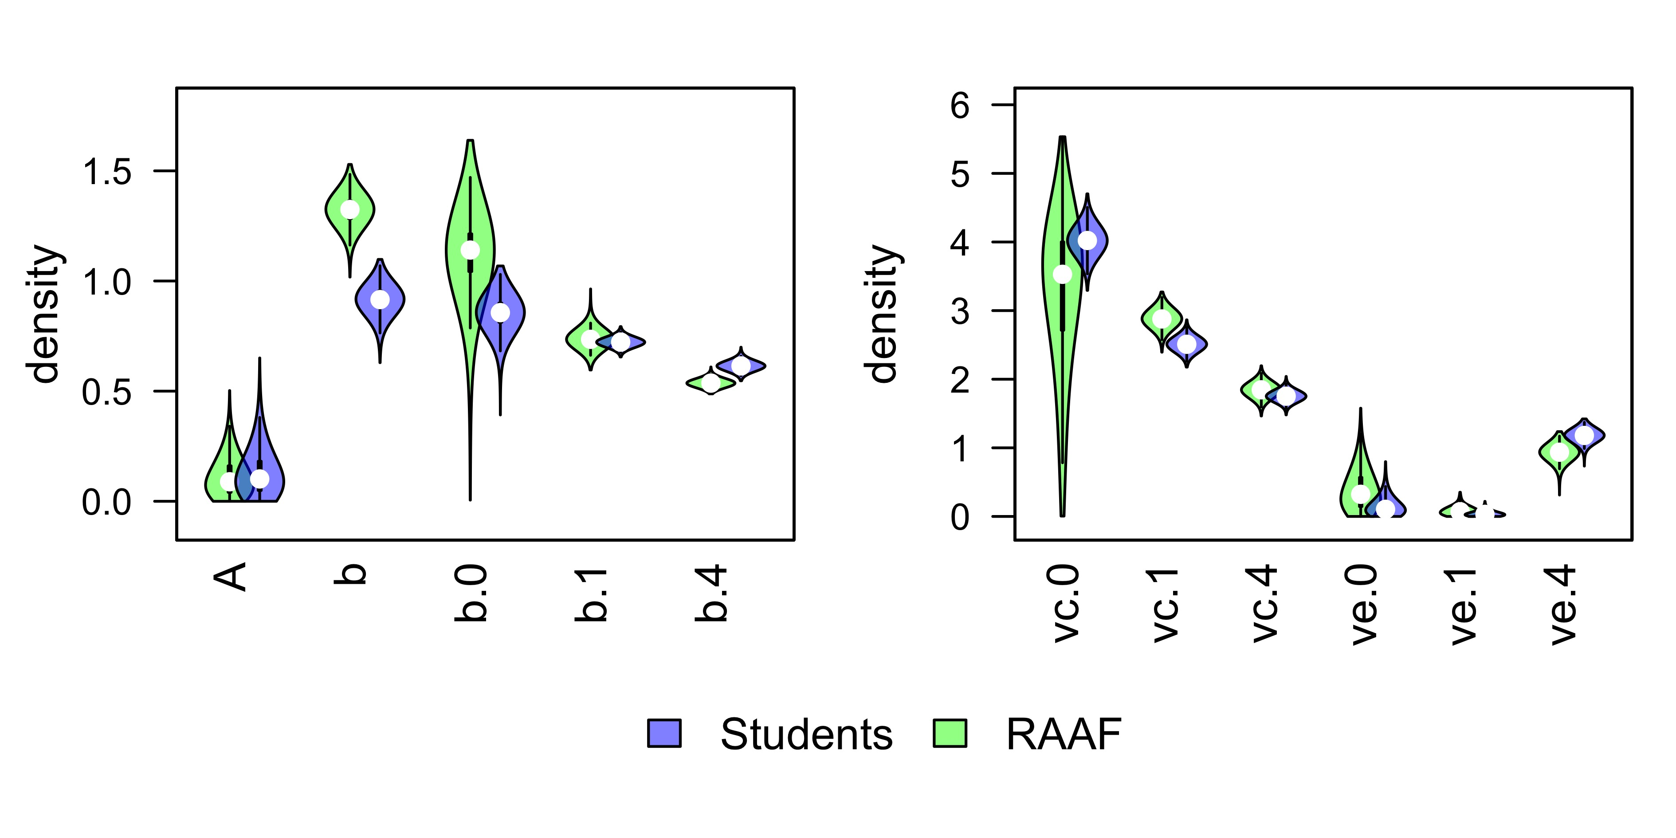
Modelling MOT decisions

Slide 45
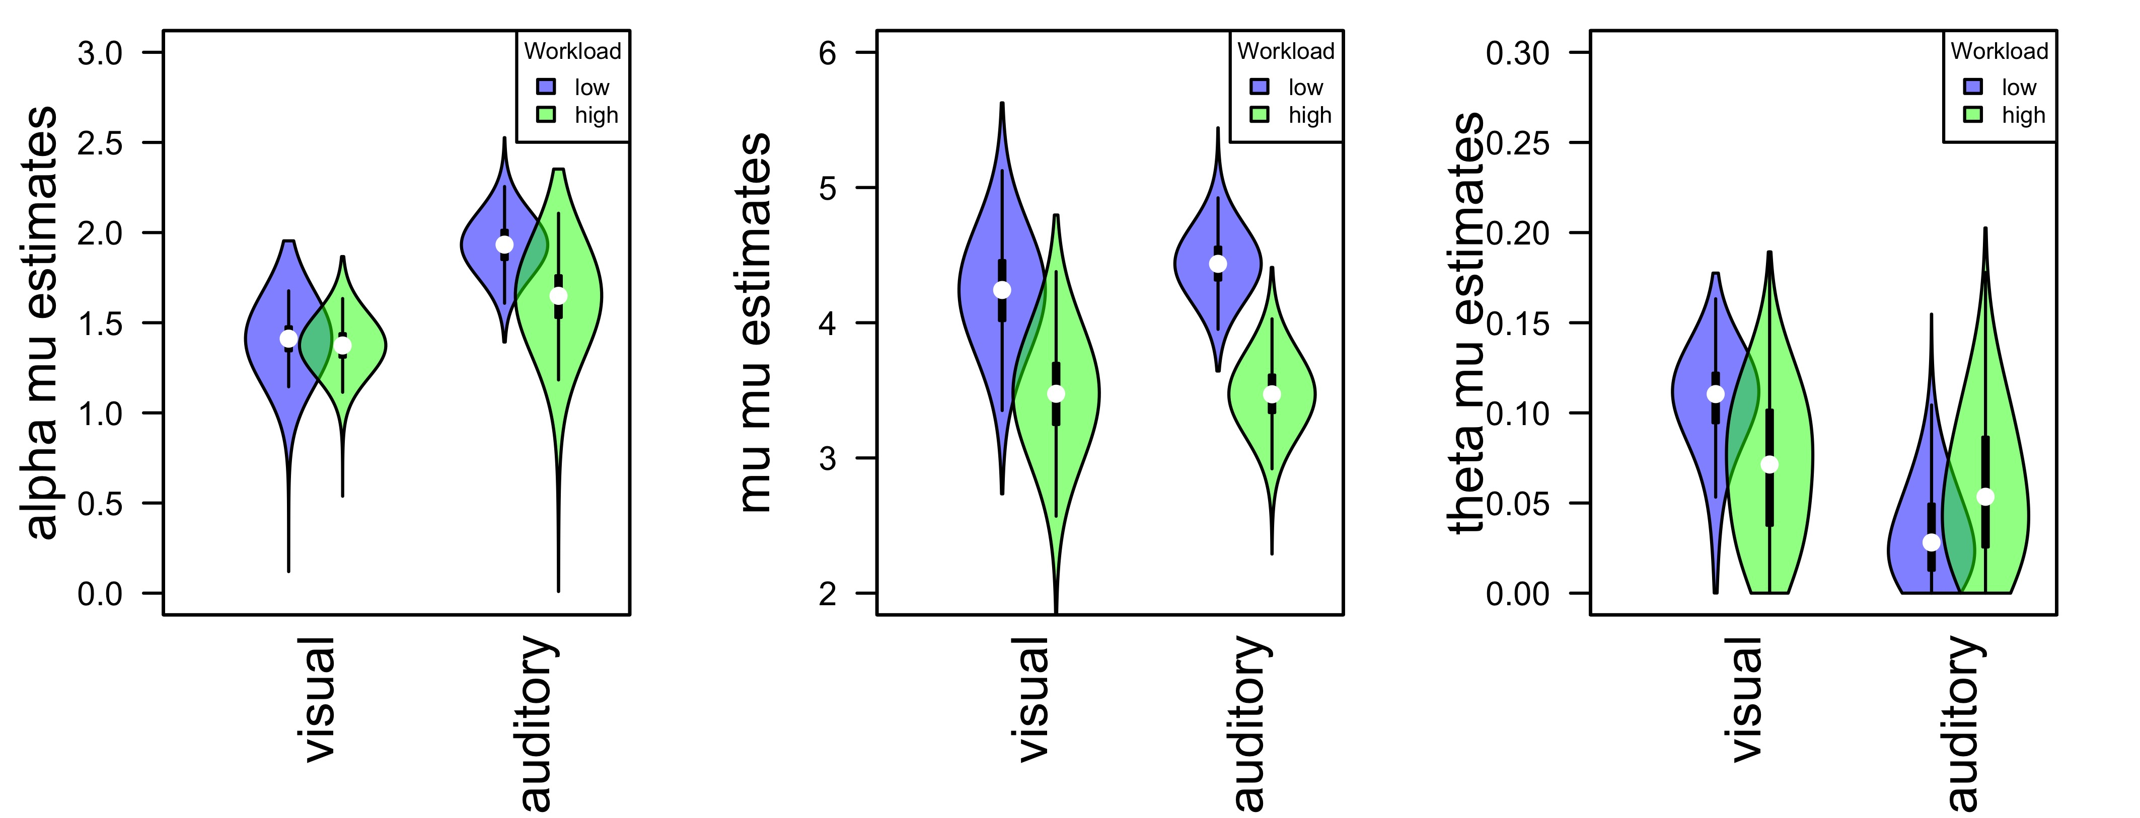
Other Modelling DRT decisions (on some other cool experiment)
Threshold
Drift
Non-Decision

Slide 46
Effects of Adding Information
Using the DRT for different purposes

Slide 47
Purpose
“The usability of the human-machine interface is dependent on the quality of its design and testing”
- Alexander Thorpe (2018)

Slide 48
Purpose
Can humans actually use it??
Is it helpful? Or is it distracting?
We see vast technology in cars now and this extends further

Slide 49
Experiment
Dual task design
Multitasking
Divided attention
Push perceptual capacity to boundaries
Uses Multiple Object Tracking task as main task to focus on
Can manipulate load by increasing difficulty
We use only 4 dots in Experiment 1 (and 3 dots in Exp 2)
Uses Detection Response Task as the measure
Secondary Task
Aim – Assess how adding information effects workload and performance

Slide 50
Experiment 1
Three different tasks (bs design) – total of 111 people
One has added text vs no info
One has added help (colour) vs no info
One has both vs no info
Look for differences in both the MOT accuracy & DRT response time

Slide 51

Added Text

Slide 52

Added help (coloured dot)

Slide 53

Added Both

Slide 54
Results
Text
Text
Dot
Dot
Both
Both
Response Time
Accuracy
DRT - RT
MOT - Accuracy

Slide 55
Experiment 2
Exactly the same
BUT!
Within subjects (N=37)
No Both condition
3 dots to track – why??

Slide 56
Results
Response Time
Accuracy
DRT - RT
MOT - Accuracy

Slide 57
Outcomes
Adding information is not always useful
Adding information can be useful but often at a cost
Practical application is important for designers

Slide 58
Airbus-Hensoldt Experiments
[practical]

Slide 59
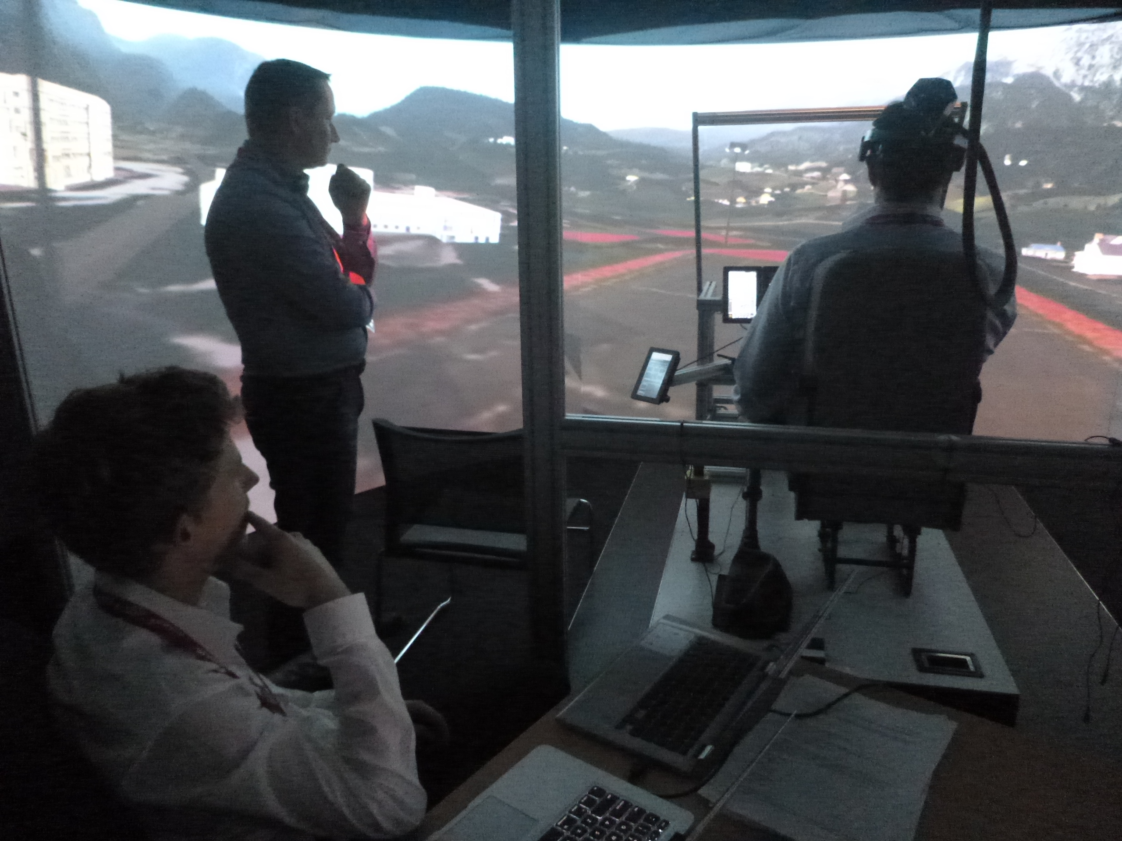

Slide 63
Is added information affecting our performance?
We might be able to drive/fly better with this help
But are we missing key information? Or not reacting where we should be?
Using simple experiments and clever analysis to solve real-world problems

Slide 64
Experiments
Fly a helicopter simulator whilst doing the DRT
Several conditions that manipulate visual conditions & symbology
Low vs High visibility
Low vs High symbology
Landings are key data

Slide 65
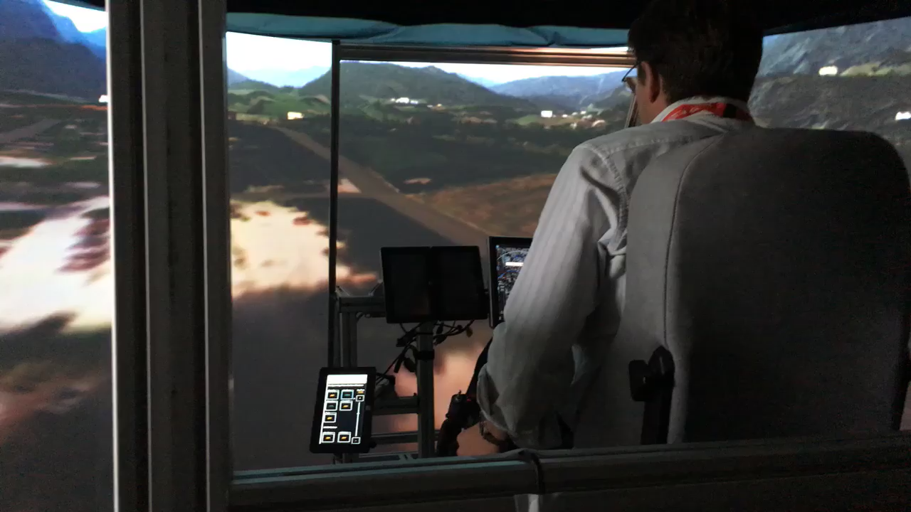

Slide 66
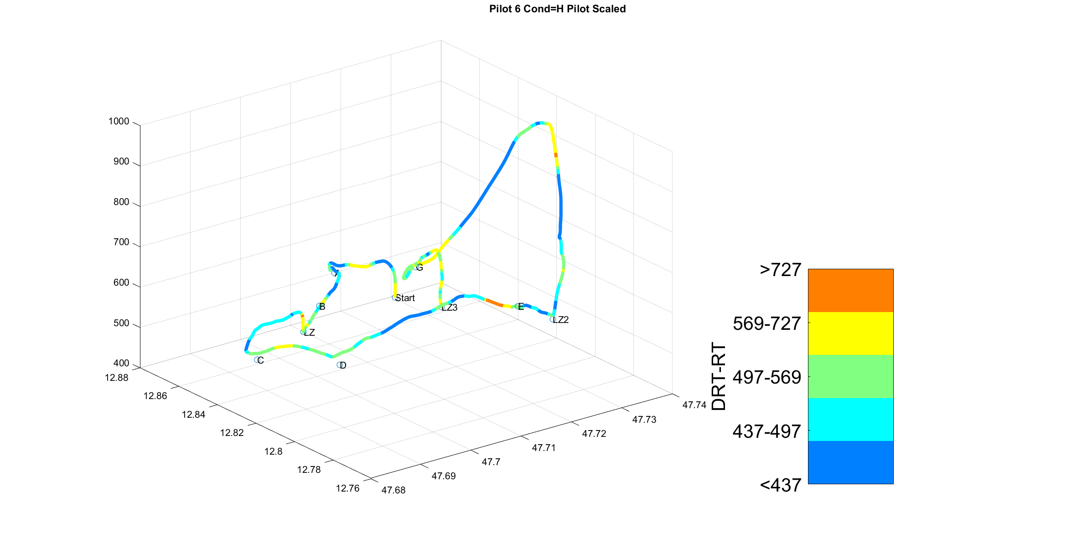


Slide 67
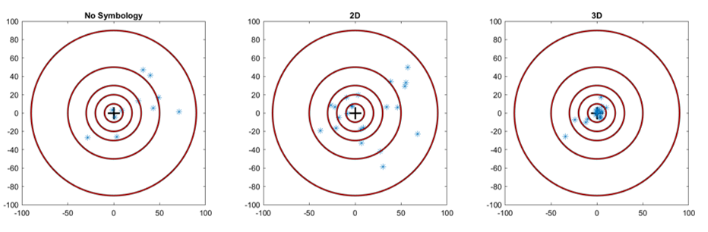
Landings

Slide 68
DRT

Slide 69
DRT

Slide 71
What does this mean?
Flying at night with no help is a bad idea
Pilots land better with symbology
Added information may have no effect on workload (which is good)
(But) Participants may be at max capacity from the simulator and other effects

Slide 72
New Estimation Approaches
[modelling]
(this is content mainly for Steven and Russell)

Slide 73
Gunawan et al. 2019 (with Guy Hawkins)
Paper is called New Estimation Approaches for the Hierarchical Linear Ballistic Accumulator Model
Anyone who has done MCMC or de-MCMC will be able to use this

Slide 74
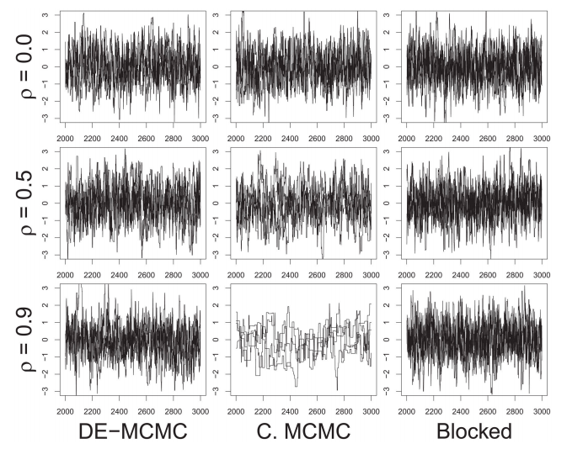
How it works
Regular de-MCMC
Turner et al. (2013)
Used to fit hierarchical models
Used when correlation of posterior is high
Complicated to estimate ‘joint models’

Slide 75
How it works
Particle Metropolis within Gibbs (PMwG)
Gunawan et al. (201)
Estimates vector of parameters as one value (alpha) for each subject
Each alpha = a ‘particle’ (multivariate normal dist)
Specify a number of particles and find the best one
(per subject)
Repeat across all subjects
NOTE: there is more complex math that underlies this

Slide 76
Advantages?
Great for correlated parameters
Able to calculate criterion values still
Great for joint modelling
Estimate parameters of two (or more) tasks/data as one alpha
Could be used in other joint modelling work…
Faster and Efficient-er
All you need for it to run is a log-likelihood function
likelihood
iterations

Slide 77
The R package (coming soon)
Soon we will be releasing a package (R) and documentation
Very easy to use and do model comparison

Slide 78
What I’m using it for
Models of LBA
Recovery and cross-fitting study
Parameters recover well and correct model selected
BUT: variance and covariance recovers well
AND: individual parameters recover well
👍🏼
Modelling my DRT-MOT data
Using shifted-Wald for DRT (~5 params) and LBA for MOT decision (~12 params)
Estimate any joint parameters (i.e. non-decision time)
Estimate correlations between parameters
Better understand the overall relationship between tasks and performance aspects
Analysis 1: RAAF vs Students
Analysis 2: Adding information

Slide 79
What others are using it for
Wall et al. (2019)
Estimating parameters for in and out of scanner (Birte’s data)
Estimating correlation of three tasks (stop signal, search & match)
Gunawan, Hawkins, Kohn, Tran & Brown (2020)
Showing how parameters change across blocks within tasks rather than across the whole task
Clustering of data – Hawkins
Showing how different people fall into different clusters within tasks
Estimating models of Decision Architecture
Classifying certain decision strategies under different models
Estimating the parameters of those decisions under the models
Testing other models
Seeing if we can break the sampler
But also checking old models to see if results hold

Slide 80

Future

Slide 81
What’s next
Finish the package and finalize key functions
Eventually move to CRAN
Finalize joint models and publish
(I have to write a thesis)
Release guide for package
Will include basic how to’s
Examples
Model comparison measures

